Slide 1
Using Containers on
RMACC Summit
Andrew Monaghan
Andrew.Monaghan@colorado.edu
Brett Milash
Brett.Milash@utah.edu
Martin Cuma
Martin.Cuma@utah.edu
Slides and exercises available for download at
https://github.com/researchcomputing/rmacc_2019_container_tutorial

Slide 2
Outline
Introduction to containers
Overview: Singularity commands and running containers
Hands-on: Running containers on RMACC Summit
Notes: Running containers for MPI and GPU jobs
/\/\/ Break /\/\/
Overview: Building containers
Hands-on: Building containers from recipes (SingularityHub)
Demo: Building containers from recipes (Sylabs Remote Bldr)
Troubleshooting, caveats and summary

Slide 3
Introduction to Containers
Seacontainersales.com

Slide 4
What is a container?
A container is a portable environment that packages some or all of the following: an operating system, software, libraries, compilers, data and workflows. Containers enable:
Mobility of Compute
Reproducibility (software and data)
User Freedom

Slide 5
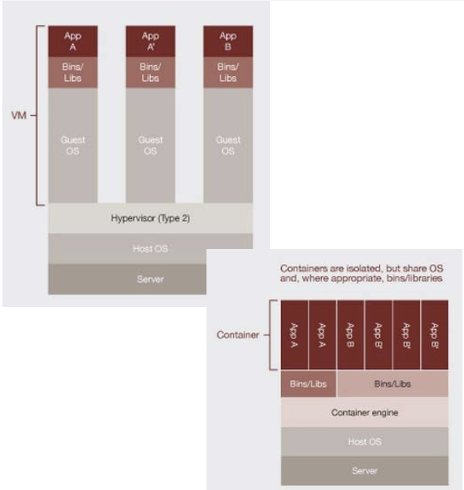
Virtualization (1)
Hardware virtualization (not used by containers!)
Can run many OS’s on same hardware (machine)
E.g., VirtualBox, VMWare
Material courtesy: M. Cuma, U. Utah

Slide 6
Virtualization (2)
OS-level virtualization (used by containers!)
Can run many isolated OS instances (guests) under a server OS (host)
Also called containers
E.g., Docker, Singularity
Best of both worlds: isolated environment that user wants, but can leverage host OS resources (network, I/O partitions, etc.)
Material courtesy: M. Cuma, U. Utah

Slide 7


Containerization software
Docker
Well established – largest user base
Has Docker Hub for container sharing
Problematic with HPC
Charliecloud; Shifter
Designed for HPC
Based on Docker
Less user-friendly
Singularity
Primary focus of today’s tutorial
More info on next slide…

Slide 8
Why Singularity?
Singularity is a comparably safe container solution for HPC
User is same inside/outside container
User cannot escalate permissions without administrative privilege
Can support MPI and GPU resources on HPC (scaling)
Can use HPC filesystems
Supports the use of Docker containers
Container is seen as a file, and can be operated on as a file

Slide 9
Singularity Overview
Singularity Workflow
Key Commands
Running Containers
Seacontainersales.com

Slide 10
The Singularity Workflow
Need Container?
no
Build software in situ on host system
yes
Does Container Exist?
yes
Run existing container
no
Interactively Develop Container
First half of tutorial
Second half of tutorial
Build Container
Run new container

Slide 11
Where do I find existing containers?
Docker Hub: https://hub.docker.com
Singularity Hub: https://singularity-hub.org
Sylabs Library: https://cloud.sylabs.io/library
Tutorial on finding a running an existing Docker container: https://www.chpc.utah.edu/documentation/software/singularity.php#exd

Slide 12
Key Singularity Commands
build: Build a container on your user endpoint or build environment
exec: Execute a command to your container
inspect: See labels, run and test scripts, and environment variables
pull: pull an image from Docker or Singularity Hub
run: Run your image as an executable
shell: Shell into your image
More: https://www.sylabs.io/guides/3.2/user-guide/cli.html

Slide 13
Running containers
Now, on any system with Singularity, even without administrative privilege, you can retrieve and use containers:
Download a container from Singularity Hub or Docker Hub
singularity pull shub://some_repo/some_image
singularity pull library://some_repo/some_image
singularity pull docker://some_repo/some_image
Run a container
singularity run mycont.sif
Execute a specific program within a container
singularity exec mycont.sif python myscript.py
“Shell” into a container to use or look around
singularity shell mycont.sif
Inspect an image
singularity inspect --runscript mycont.sif

Slide 14
Hands-on Examples
Running containers with Singularity
Seacontainersales.com

Slide 15
Logging in
If you are using a temporary account: In a terminal or Git Bash window, type the following:
ssh –X userNNNN@tlogin1.rc.colorado.edu
Password:
If you are using your regular RC account (e.g., ‘monaghaa’ for me), log in as you normally would.
**Note that userNNNN is a temporary account that I have assigned to you, along with a password. If you do not have one, let me know.

Slide 16
Getting on a compute node
Navigate to scompile
ssh scompile
Now start an interactive job:
sinteractive –n 2 –t 90 –-reservation=container
Load singularity and set up environment
module load singularity/3.0.2
export SINGULARITY_TMPDIR=/scratch/summit/$USER
export SINGULARITY_CACHEDIR=/scratch/summit/$USER
…We will go through examples together in the following slides.

Slide 17
Navigating
Now type the following commands:
cd /scratch/summit/$USER
git clone https://github.com/researchcomputing/rmacc_2019_container_tutorial
cd rmacc_2019_container_tutorial
ls
You should see some directories. We will use these for the hands-on examples.

Slide 18
Go to the example directory
Now go to the Singularity example directory
cd run_singularity_basic
List the contents of the directory and see a description of each file:
ls
If you get behind or have issues, look in ‘tutorial_steps.txt’
cat tutorial_steps.txt

Slide 19
Running a container from Singularity Hub
Pull an existing container image that someone else posted:
singularity pull --name hello.sif shub://monaghaa/singularity_git_tutorial
…And run it
singularity run hello.sif
…And look at the script inside
singularity exec hello.sif cat /code/hello.sh

Slide 20
Running a container from Docker Hub
Let’s grab the stock docker python container:
singularity pull --name pythond.sif docker://tatsushid/tinycore-python
…And run python
singularity exec pythond.sif python
…And shell into the container and look around
singularity shell pythond.sif
…try “ls /” What directories do you see?

Slide 21
Running a container from Docker Hub (2)
Let’s run an external python script using the containerized version of python:
First create a script called “myscript.py” as follows:
echo 'print("hello world from the outside")' >myscript.py
…And now let’s run the script using the containerized python
singularity exec pythond.sif python ./myscript.py
…Conclusion: Scripts and data can be kept inside or outside the container. In some instances (e.g., large datasets or scripts that will change frequently) it is easier to containerize the software and keep everything else outside.

Slide 22
Running an MPI container
MPI-enabled Singularity containers can be deployed on RMACC Summit, with the caveat that the MPI software within the container must be consistent with MPI software available on the system. This requirement diminishes the portability of MPI-enabled containers, as they may not run on other systems without compatible MPI software. Regardless, MPI-enabled containers can still be a very useful option in many cases.
Here we provide an example of that uses a gcc compiler with OpenMPI. Let’s pull it from Dockerhub first:
singularity pull hello_openmpi.sif shub://monaghaa/hello_openmpi_summit
In order to use it, we load the gcc and openmpi modules on Summit (these are consistent with the gcc/openmpi versions installed in the container)
module load gcc/6.0.1
module load openmpi/2.0.1
To run it, simply preface the ‘singularity exec <stuff>’ command with ‘mpirun –n <numprocs>’:
mpirun -n 2 singularity exec hello_openmpi.sif mpi_hello_world

Slide 23
Binding directories
Depending on how Singularity is configured on a given host system, host directories may be “bound” (mounted) by default. But sometimes you may want to access a directory that is not already mounted. Here’s how you can do it:
singularity shell –bind /outsidedir:/insidedir pythond.sif
…It isn’t necessary to bind like-named directories like we did above. Try binding your /home/$USER directory to /opt.
***Note: If your host system does not allow binding, you will need to create the host directories you want mounted when you build the container (as root on, e.g., your laptop)

Slide 24
Notes: MPI and GPUs
Seacontainersales.com

Slide 25
Notes: MPI-enabled containers
RMACC Summit uses an Omnipath interconnect (a low latency network that enables MPI to be efficiently implemented across nodes). In order to use a Singularity container with OpenMPI (or any MPI) on Summit, there are two requirements:
The Singularity container needs to have Omnipath libraries installed inside.
OpenMPI needs to be installed both inside and outside of the Singularity container. More specifically, the SAME version of OpenMPI needs to be installed inside and outside (at least very similar, you can sometimes have two different minor versions, ex: 2.1 and 2.0).
An example Singularity recipe in the tutorial Github repository named “Singularity_openmpi.def” can be used as a template to build MPI-enabled container images for RMACC Summit. It ensures that OpenMPI 2.0.1 is installed in the image, which matches the openmpi/2.0.1 module that is available on RMACC Summit.
Note that it is also possible to build intel/IMPI containers for use on RMACC Summit, which are likely to have enhanced performance on Summit’s intel architecture compared to gcc/OpenMPI containers. If you would like assistance building MPI-enabled containers contact rc-help@colorado.edu.

Slide 26
Running containers on GPUs
Syntax (after loading Singularity on a gpu node [”--partition=sgpu”]):
singularity exec --nv docker://tensorflow/tensorflow:latest-gpu python mytensorflow_script.py
With the --nv option the driver libraries do not have to be installed in the container. Instead, they are located on the host system (e.g., RMACC Summit) and then bind mounted into the container at runtime. This means you can run your container on a host with one version of the NVIDIA driver, and then move the same container to another host with a different version of the NVIDIA driver and both will work. (Assuming the CUDA version installed in your container is compatible with both drivers.)
The present NVIDIA Driver on RMACC Summit is 390.48, which is compatible with CUDA 9.1 or lower.
This means you can build a container by bootstrapping a base NVIDIA CUDA image (9.1 or lower) from: https://hub.docker.com/r/nvidia/cuda/
NVIDIA has a tool for building gpu-enabled containers for both Singularity and Docker. See: https://github.com/NVIDIA/hpc-container-maker

Slide 27
/\/\/ BREAK /\/\/
Task for next session: Create a github a account if you don't already have one.
https://github.com/join
{Remember your username and password!}

Slide 28
Review
On any system with Singularity, even without administrative privilege, you can retrieve and use containers:
Download a container from Singularity Hub or Docker Hub
singularity pull shub://some_repo/some_image
Singularity pull library://some_repo/some_image
singularity pull docker://some_repo/some_image
Run a container
singularity run mycont.sif
Execute a specific program within a container
singularity exec mycont.sif python myscript.py
“Shell” into a container to use or look around
singularity shell mycont.sif
Inspect an image
singularity inspect --runscript mycont.sif

Slide 29
Building containers
Seacontainersales.com

Slide 30
There are 3 ways to build a Singularity container
Build a container on a system on which you have administrative privilege (e.g., your laptop).
Pros: You can interactively develop the container.
Cons: Requires many GB of disk space, requires administrative privilege, must keep software up-to-date, container transfer speeds can be slow depending on personal network connection.
Build a container on Singularity Hub using recipe, Github
Pros: Essentially zero disk space required on your system, doesn’t require administrative privilege, no software upgrades needed, easy to retrieve from anywhere, typically faster transfers from Singularity Hub to desired endpoint.
Cons: Cannot interactively develop the container
Build a container on Sylabs remote builder
Pros: Essentially zero disk space required on your system, doesn’t require administrative privilege, no software upgrades needed, easy to retrieve from anywhere, final container is placed on local machine
Cons: Cannot interactively develop the container, ‘Freemium’ version limited

Slide 31
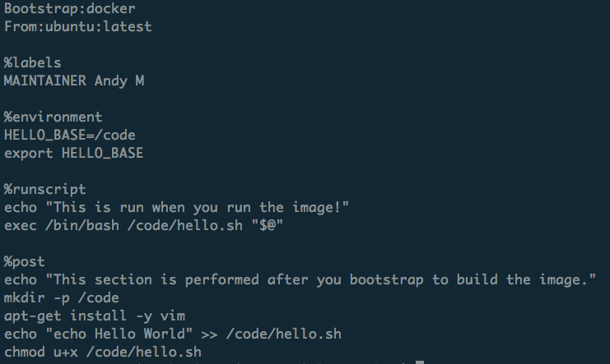
What is a recipe?
Header
Metadata
Runtime environment variables
Default program at runtime
Where software and directories are installed at buildtime
More: https://www.sylabs.io/guides/3.2/user-guide/definition_files.html

Slide 32
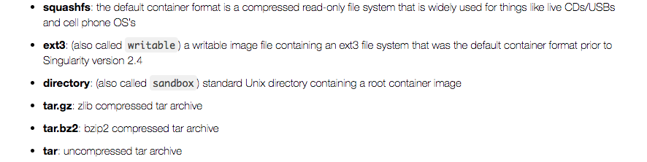
Container Formats
*.sif format and older *.simg format
(immutable final container format)
Writeable sandbox used for interactive container development
https://singularity.lbl.gov

Slide 33
1. Building a container interactively
Bootstrap a base container (has OS you want, maybe other stuff too) into a sandbox:
sudo singularity build --sandbox mytest/ docker://alpine:latest
Shell into the container and install what you need by trial and error:
sudo singularity shell –-writable mytest/
[now do stuff in container; as you get it correct, add commands to Singularity recipe]
Now finalize container.
You can either build squashfs image from sandbox:
sudo singularity build mytest.sif mytest/
Or you can build squashfs image from recipe (best practice):
sudo singularity build mytest.sif Singularity

Slide 34
2. Building a container on Singularity Hub (basic steps)
Create a recipe file for your container
Name it “Singularity”
Create a github repository for your container
Upload it to your github repository
Log into Singularity Hub using your github username/password
Go to “My Collections” and choose “ADD A COLLECTION”
Select the github repository you just uploaded.
The container will build automatically.
Revised recipes are automatically rebuilt when pushed to github.
Additional details at: https://github.com/singularityhub/singularityhub.github.io/wiki
**Note: You can build Docker containers on Docker Hub using a nearly identical process!

Slide 35
Hands-on Example
Build a container on Singularity Hub
Seacontainersales.com

Slide 36
Logging in
If you are using a temporary account: In a terminal or Git Bash window, type the following:
ssh –X userNNNN@tlogin1.rc.colorado.edu
Password:
If you are using your regular RC account (e.g., ‘monaghaa’ for me), log in as you normally would.
**Note that userNNNN is a temporary account that I have assigned to you, along with a password. If you do not have one, let me know.

Slide 37
Getting on a compute node
Navigate to scompile
ssh scompile
Now start an interactive job:
sinteractive –n 2 –t 90 –-reservation=container
Load singularity and set up environment
module load singularity/3.0.2
export SINGULARITY_TMPDIR=/scratch/summit/$USER
export SINGULARITY_CACHEDIR=/scratch/summit/$USER
…We will go through examples together in the following slides.

Slide 38
Go to the example directory
Go to the Singularity Hub example directory
cd /scratch/summit/$USER/rmacc_2019_container_tutorial/build_container_on_shub/
List the contents of the directory and see a description of each file:
ls
If you get behind or have issues, look in ‘tutorial_steps.txt’
cat tutorial_steps.txt

Slide 39
Prepare and upload your recipe
Use a text editor to explore and customize the recipe file ‘Singularity’:
nano Singularity
Can you determine the purpose of each section?
Can you determine what this container does?
Are there any files copied to the container?
Now change the ‘Maintainer’ to your name
To exit and save type [ctrl-x], then “y”, then [enter].
Now we are ready to build a container on Singularity Hub using this recipe. Recall that we do this by creating a github repository containing the ‘Singularity’ recipe file. For the sake of time we’ve created a script to facilitate this step. Type:
./make_git_repo.sh <your-github-username>
You will be prompted for your github password 2 times while the script is running; enter it each time. User your browser to confirm your repository was created:
https://github.com/<your-github-username>/build_container_on_shub

Slide 40
Build your container on ‘shub’
Now navigate to Singularity Hub in your browser:
https://www.singularity-hub.org/
…and do the following:
Go to the "login" link in the upper right corner and login with your github credentials
Choose "GITHUB", not "GITHUB (WITH PRIVATE)"
Go to "My container collections”
Go to "Add a Collection”
Choose "<your-github-username>/build_container_on_shub" and click on "SUBMIT”
This will take you another page while your container builds. You can click "refresh" to check it's status. It may take several minutes.
If your container builds successfully, you will see a green ‘Complete’ button. If not, let us know and we’ll help: you can quickly fix and re-commit the recipe to github, which will initiate another build on Singularity Hub.

Slide 41
Now pull your container from ‘shub’ and run it!
Now navigate to Singularity Hub in your browser:
singularity pull --name mytranslator.sif shub://<your-github-username>/build_container_on_shub
Run your container with the ‘inside’ version of the python script:
singularity run mytranslator.sif
…and run your container with the ‘outside’ version of the python script:
singularity exec mytranslator.sif python ./text_translate.py
(hint: you can change the language in ./text_translate.py to confirm that the outside script is running)

Slide 42
3. Building a container with Sylabs Remote Builder (demo)
Get a token from Sylabs Cloud: https://cloud.sylabs.io/auth
Login using your Github account
Provide a label under “Create a New Access Token”
Click “Create New Token”
Copy the token string (<your-token>)
Add the token on your host machine:
mkdir ~/.singularity
echo “<your-token>” > ~/.singularity/sylabs-token
Issue the command to build your container remotely
singularity build --remote myimage.sif myrecipe.def
If successful, the container will be placed in your working directory

Slide 43
Troubleshooting & Caveats
Seacontainersales.com

Slide 44
Troubleshooting (1)
Container/host environment conflicts
Container problems are often linked with how the container “sees” the host system. Common issues:
The container doesn’t have a bind point to a directory you need to read from / write to
The container will “see” python libraries installed in your home directory (and perhaps the same is true for R and other packages. If this happens, set the PYTHONPATH environment variable in your job script so that it points to the container paths first.
export PYTHONPATH=<path-to-container-libs>:$PYTHONPATH
To diagnose the issues noted above, as well as others, “shelling in” to the container is a great way to see what’s going on inside. Also, look in the singularity.conf file for system settings (can’t modify).

Slide 45
Troubleshooting (2)
Failures during container pulls that are attributed (in the error messages) to *tar.gz files are often due to corrupt tar.gz files that are downloaded while the image is being built from layers. Removing the offending tar.gz file will often solve the problem.
”Pulling” containers onto Summit can require substantial diskspace and can often fill up the /tmp directory with temporary files. Setting an alternate temporary directory as follows can alleviate this issue:
export SINGULARITY_TMPDIR=/scratch/summit/$USER
When building containers, failures during %post stage of container builds from a recipe file can often be remedied by starting the %post section with the command “apt-get update” or “yum -y update” (depending on which Linux version you install). As a best practice, make sure you insert this line at the beginning of the %post section in all recipe files for ubuntu containers.

Slide 46
Caveats (1)
We didn’t cover the following topics
Container security and verification
Searching for containers
Overlays
Running services with containers (“instances”)
Setting environment variables at runtime
Installing Singularity on your laptop or desktop machine
Best practices (see Aaron Holt’s RMACC presentation)
https://github.com/ResearchComputing/container-best-practices-rmacc19
For information on these and other topics: https://www.sylabs.io/docs/

Slide 47
Caveats (2): Moving containers
You’ve built your first container on your laptop. It is 3 Gigabytes. Now you want to move it to Summit to take advantage of the HPC resources. What’s the best way?
Remember, containers are files, so you can transfer them to Summit just as you would a file:
Command line utilities (scp, sftp)
Globus (recommended)
For more on data transfers to/from Summit: https://curc.readthedocs.io/en/latest/compute/data-transfer.html

Slide 48
Thank you!
Please fill out the survey:
http://tinyurl.com/curc-survey18
Additional learning resources:
Slides and Examples from this course:
https://github.com/researchcomputing/rmacc_2019_container_tutorial
Web resources:
https://curc.readthedocs.io/en/latest/software/ContainerizationonSummit.html
https://www.chpc.utah.edu/documentation/software/containers.php
https://www.sylabs.io/docs/ (documentation for Singularity)
https://www.singularity-hub.org/ (Singularity Hub)
https://cloud.sylabs.io/library (Sylabs Library)

